Slide 1

ISSC Notes Training
Lotus Script
Zhang Li
2004.04

Slide 2
Agenda
Summary
Where to use Lotus Script
Back End Classes & UI Classes
The Back End Classes
Domino Object Hierarchy(Back End)
The Front End(UI) Classes
Working with Lotus Script
Using Lotus Script
Self check

Slide 3
Summary
Superset of BASIC, No GUI Design Tools.
Full object-oriented programming language.
Predefined classes.
Automatically compilation and loading of user code. Automatically includes the Domino class definitions.
Access to a broad range of product functions through the classes defined for each product.
Access to external class libraries defined using the the LSX Toolkit.
Cross-platform
Interoperability with other languages

Slide 4
Where to use Lotus Script
The programming logic is not simple
Loops, Select(Case) constructs, and a lot more
Some capabilities that formulas do not provide(e.g. ACL)
Coexistence with Notes @functions
Access stored databases (back-end)
Access other Notes Databases
Access non-Notes data sources

Slide 5
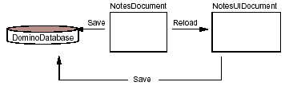
Back End Classes & UI Classes
Domino
    Back End Classes
Notes
    UI Classes

Slide 6
The Back End Classes
NotesSession
Database
XML
View
DocumentCollection
Document
ViewNavigator
Item
ViewEntryCollection
RichTextItem
ViewEntry

Slide 7
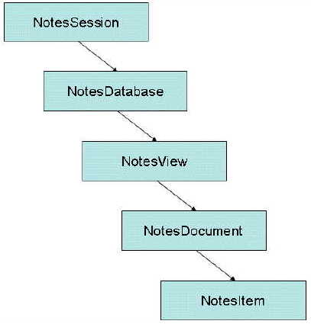
Domino Object Hierarchy(Back End)
NotesSession
NotesDatabase
NotesView
NotesDocument
NotesItem

Slide 8
The Front End(UI) Classes
NotesUIWorkspace
NotesUIDatabase
NotesUIView
Button
NotesUIDocument
Field
Navigator

Slide 9
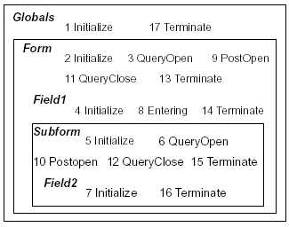
Working with Lotus Script
Agents
  On Event
  On Schedule
Events
  Database, Form, View, Field, Button
  Action
Script Libraries
  Common Modules

Slide 10
Using Lotus Script
Example 1: Getting the text of the Subject Field.
  Dim session as New NotesSession
  Dim db as NoteDatabase
  Dim view as NotesView
  Dim doc as NotesDocument
  Dim item as NotesItem
  Set db=session.CurrentDatabase
  Set view=db.GetView(“Main View”)
  Set doc=view.GetFirstDocument
  Set item=doc.GetFirstItem(“Subject”)
  Call MessageBox (item.Text)

Slide 11
Using Lotus Script(Continued)
Example 2: Examines the current view as it is opened and queries the user if the view is a calendar view.
  Sub Queryopen(Source As Notesuiview, Continue As Variant)
  Dim view As NotesView
  Set view = Source.View
  If view.IsCalendar Then
  If Messagebox ("Do you want to continue?", _
  MB_ICONQUESTION, _
  "Calendar view") = IDNO Then
  Continue = False
  End If
  End If
  End Sub

Slide 12

Self Check
ScriptSelfCheck.doc

